Slide 1
App Based Valuation Reports of Mobile Assets
PIP104 University Project-II
Review-1
Batch Number:
Under the Supervision of,
Dr. Pajany M
Assistant Professor
School of Computer Science & Engineering
Presidency University
ROLL NUMBER | STUDENT NAME
20211CSE0413 | SUSHMA M MADDIN
20211CSE0421 | SINCHANA A U
20211CSE0437 | K H SRUJAN GOWDA
20211CSE0444 | CHETHA SHREE R

Slide 2
Introduction
In today's fast-paced world, the need for efficient and accurate mobile asset valuation is essential, especially for industries involved in bidding and auctions. The current process is semi-automatic, relying on manual efforts to inspect, photograph, and document asset information. This project aims to develop a mobile application that automates the entire valuation process, from asset inspection to generating final reports with integrated digital signatures, eliminating the need for physical copies. By utilizing secure cryptographic techniques and integrating photograph-based verification, the proposed system offers a seamless and secure end-to-end solution for asset valuation. The system will not only enhance efficiency but also ensure data authenticity and integrity through the use of public-key cryptography for digital signatures.

Slide 3
Literature Review
Existing mobile applications for valuation and inspection, such as insurance apps (e.g., Allstate Digital Locker and Progressive Insurance App) and industry-specific tools like Procore and CoreLogic, offer several advantages. They streamline processes by providing easy data collection, photo capture, real-time reporting, and cloud integration, making inspections more efficient and accessible. Many of these apps are user-friendly, enable collaboration, and reduce the reliance on manual paperwork. However, these apps also have significant limitations. They often lack automated valuation algorithms, are highly specialized for certain industries (e.g., real estate, automotive, agriculture), and may require manual data entry, which can introduce inefficiencies and inconsistencies. Additionally, most existing apps focus on specific functions like maintenance tracking or claims processing, without offering comprehensive support for mobile asset valuation across different sectors. This highlights the need for a more versatile and automated solution that addresses the broader requirements of mobile asset inspection, valuation, and reporting.

Slide 4
Proposed Method
The proposed system will be a mobile application that automates the entire asset valuation process. The app will include the following features:
Automated Inspection: Real-time image processing for asset evaluation during site inspections.
Digital Signature Integration: Secure the valuation reports with public-key cryptography, ensuring that only authorized personnel can sign and validate the reports.
Report Generation: Automate the generation of PDF reports, embedding digital signatures and timestamps.
Cost Estimation: Implement algorithms to calculate the value of assets and provide accurate cost reports for bidders

Slide 5
Objectives
Develop a mobile app to automate the entire asset valuation process from inspection to report generation.
Incorporate digital signature functionality to authenticate and secure reports.
Eliminate the need for physical documentation by integrating a fully digital workflow.
Use image processing techniques for real-time asset inspection and verification.
Automate cost estimation and provide secure digital reports to bidders.

Slide 6
Methodology
Requirement Analysis: Identifies core users (e.g., appraisers, inspectors, buyers) and gathers functional needs like data capture, valuation algorithms, and report generation, while ensuring scalability, security, and regulatory compliance.
System Architecture Design: Develops a user-friendly mobile app for asset input and digital signatures, backed by a robust system for data storage, valuation algorithms, API integration, and cloud storage for real-time data access.
Data Capture and Automation: Incorporates features for photo capture with geotagging, automated asset valuation through algorithms, and customizable checklists to standardize inspections.
Report Generation: Automates PDF report creation, allowing customization and secure sharing via cloud or email.
Security and Compliance: Ensures digital signatures, encryption, and adherence to data protection regulations like GDPR.
Testing and Validation: Involves beta testing with user groups to validate app performance and algorithm accuracy using real-world data.
Final Deployment: Launches the app on platforms like iOS and Android, followed by ongoing maintenance, updates, and feature improvements based on user feedback.

Slide 7
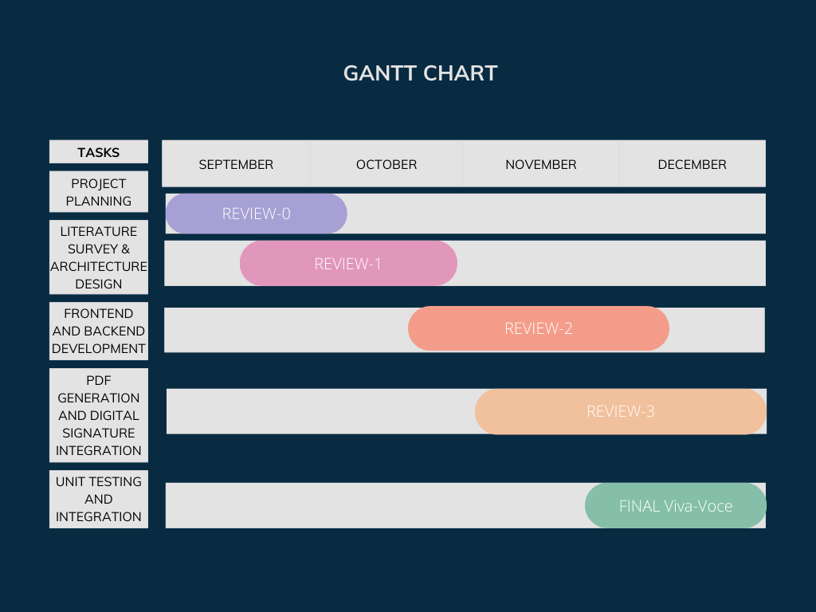
Timeline of Project

Slide 8
Expected Outcomes
The development of the app-based valuation system for mobile assets is expected to achieve the following outcomes:
Automation of Valuation Processes The system will significantly reduce manual intervention by automating the entire valuation process. This includes data collection, condition assessment, and report generation, thereby improving efficiency and consistency in asset valuation across industries.
Improved Accuracy and Consistency in Asset Valuation The use of machine learning models or predefined algorithms will ensure accurate, data-driven valuations. By eliminating subjective assessments, the system will provide more reliable and consistent valuation reports for mobile assets such as vehicles, machinery, and equipment.
Faster Report Generation and Delivery The app will enable real-time data capture and instant report generation, allowing users to share detailed, standardized valuation reports with stakeholders (e.g., buyers, insurers, financiers) immediately after an inspection. This reduces delays and speeds up decision-making processes, such as insurance claims, asset sales, and financing approvals.
Enhanced Security and Compliance By incorporating digital signatures, data encryption, and regulatory compliance, the app will ensure the authenticity, security, and legal validity of valuation reports. This will help in meeting industry standards and regulations, building trust among users and stakeholders.

Slide 9
Expected Outcomes
Cross-Industry Applicability and Customization The system will be flexible enough to cater to a wide range of industries, including automotive, construction, agriculture, and real estate. Customizable templates and checklists will make the app adaptable to different types of assets and regulatory requirements, broadening its usability across sectors.
Increased Scalability and Accessibility With cloud-based storage and mobile access, the app will allow users to conduct valuations from anywhere, making the system scalable for large organizations and accessible for smaller businesses and individual users alike.

Slide 10
Conclusion
The app-based valuation system for mobile assets offers a transformative solution to the challenges of traditional asset valuation processes. By automating data collection, valuation, and report generation, the system enhances efficiency, accuracy, and transparency. It reduces reliance on manual interventions and subjective assessments, delivering consistent and reliable results across industries. The integration of real-time data capture, digital signatures, and cloud-based storage ensures that the valuation process is faster, more secure, and compliant with regulatory standards. Furthermore, the app’s flexibility and scalability make it adaptable for a wide range of industries, from automotive to construction and agriculture. This innovation has the potential to streamline asset management, improve decision-making, and increase the overall effectiveness of valuation practices, setting a new standard for mobile asset evaluation.

Slide 11
References
1. The Role of Automated Valuation Models (AVMs)
https://www.researchgate.net/publication/348785878_The_Digital_Transformation_of_the_Valuation_Sector_in_the_World_of_Algorithms
2. Review paper (5mins read)
https://capeanalytics.com/blog/incorporating-ai-into-the-real-estate-appraisal-process/
3. Post
https://www.matellio.com/blog/automated-valuation-model-for-real-estate/

Slide 12
Thank You

